Slide 1
Hypothesis Testing Exercise
A F&B manager wants to determine whether there is any significant difference in the diameter of the cutlet between two units. A randomly selected sample of cutlets was collected from both units and measured? Analyze the data and draw inferences at 5% significance level. Please state the assumptions and tests that you carried out to check validity of the assumptions.
Minitab File : Cutlets.mtw

Slide 2
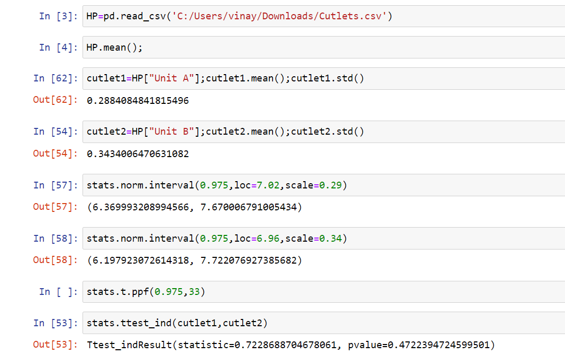
Solution
The p-value is greater that of alpha value i.e., 0.47 > 0.05, and
the assumptions is to accept the 'null hypothesis' and t –test is to be carried out .

Slide 3
Hypothesis Testing Exercise
A hospital wants to determine whether there is any difference in the average Turn Around Time (TAT) of reports of the laboratories on their preferred list. They collected a random sample and recorded TAT for reports of 4 laboratories. TAT is defined as sample collected to report dispatch.
Analyze the data and determine whether there is any difference in average TAT among the different laboratories at 5% significance level.
Minitab File: LabTAT.mtw

Slide 4
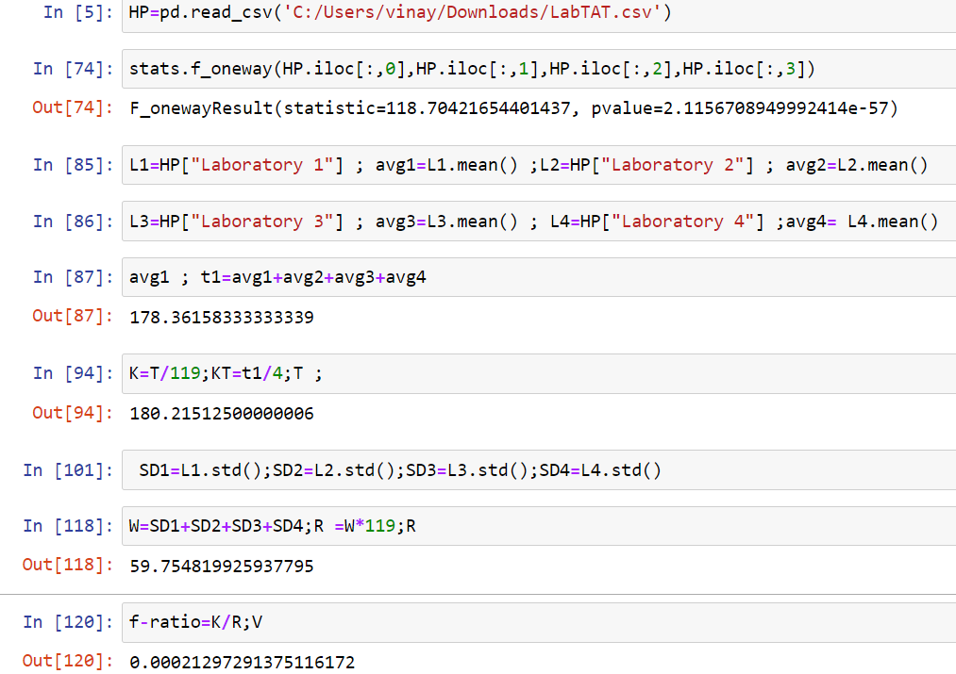
Solution
More than 2 sample and continuous, discrete data so, Anova test should perform
P-value is 2.115e-57 < 0.05 . So accept the Alternate hypothesis .
Determining BSS and WSS ,So that to find f-ratio , which is 0.00021 < 0.05.

Slide 5
Hypothesis Testing Exercise
Sales of products in four different regions is tabulated for males and females. Find if male-female buyer rations are similar across regions.
 | East | West | North | South
Males | 50 | 142 | 131 | 70
Females | 550 | 351 | 480 | 350
Check p-value
If p-Value < alpha, we reject Null Hypothesis
H0
All proportions are equal
Ha
Not all Proportions are equal
Buyer Ratio.mtw

Slide 6
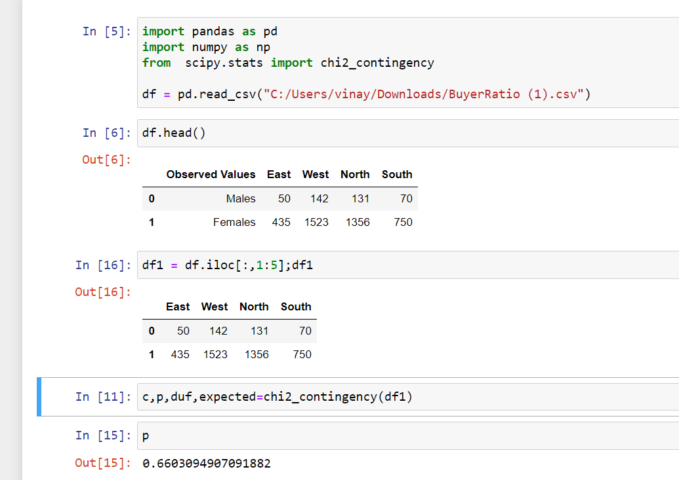
Solution
From the below data we can conclude that p-value is greater than alpha value, So
we need to except the null hypothesis and reject the alternate hypothesis as variable.
And there is no relationship between the categorical variable.

Slide 7
Hypothesis Testing Exercise
TeleCall uses 4 centers around the globe to process customer order forms. They audit a certain % of the customer order forms. Any error in order form renders it defective and has to be reworked before processing. The manager wants to check whether the defective % varies by centre. Please analyze the data at 5% significance level and help the manager draw appropriate inferences
Minitab File: CustomerOrderForm.mtw
Fantaloons Sales managers commented that % of males versus females walking in to the store differ based on day of the week. Analyze the data and determine whether there is evidence at 5 % significance level to support this hypothesis.
Minitab File: Fantaloons.mtw

Slide 8
Solution

